Slide 1
Persistent Data Structures (Version Control)
Ephemeral
Partial persistence
Full
persistence
Confluently
persistence
Purely functional
v₀
version
list
v₀
version
tree
v₀
version DAG
v₀
car cdr
update
v₁
v₁
never modify
only create new pairs
only DAGs
v₁
v₂
v₁
v₂
v₂
v₂
v₃
v₆
v₃
query only
v₃
v₃
v₄
v₅
v₅
updates at leaves
any version can be copied query all versions
update/merge/query all versions
v₄
v₄
v₅
v₅
Retroactive
v₀
v₁
v₂
v₃
v₄
v₆
v₆
update & query all versions
updates in the past propragate
update & query
query

Slide 2
Retroactive Data Structures
[E.D. Demaine, J. Iacono, S. Langerman, Retroactive Data Structures, Proc. 15th Annual ACM-SIAM Symposium on Discrete Algorithms, 274-283, 2004]
r
v₀
v₁
v₂
v₃
v₄
m
m Total number of updates/versions
r Distance from current time
n Maximal data structure size at any time
Partial retroactive Update all versions & query current
Full retroactive Update & query all versions

Slide 3
Rollback → Full Retroactivity
current
v₀
v₁
v₂
v₃
v₄
Update u₁
u₂
u₃
u₄
Change Δ₁
Δ ₂
Δ ₃
Δ ₄
+ Generic, can always be applied, space efficient - Slow retroactive operations
Notes:
+ Generic, applies can be applied, space efficient
- Slow retroactive operations

Slide 4
Lower bounds for Retroactivity
a₀ + a₁x + a₂x² + ∙∙∙ + a_{n}x^{n}
( requires Ω(n) multiplications given x by Motzkin’s theorem )
*
x₀ | x₁ | x₂ | ∙∙∙ | x_{i} | ∙∙∙ | x_{n}
( prefix sum queries require Ω(log n) )
* [M. Patrascu, E.D. Demaine, Logarithmic Lower Bounds in the Cell-Probe Model, SIAM J. of Computing 35(4): 932-963, 2006]

Slide 5
Partial → Full Retroactivity
Θ(√m)
current
v₀
v₁
v₂
v₃
½
v₄
v₅
v₆
v₇
v₈
v₉
u₁
u₂
u₄
u₅
u₆
u₇
u₈
u₉
u₃
v₄
v₅
partial retroactive structures
(remember using full persistence)
temporary during queries to V₅ (rollback)
Notes:
Splitting of overflowing intervals by using full persistence & applying remembered updates

Slide 6
Partial Retroactive Commutative Data Structures
Notes:
4.1: Trivial – just insert the operation in the present
4.2: Trivial – just invert the operation in the present
4.3: 4.2 applies to dictionaries and other problems maintaining a set with insertions & deletions

Slide 7
Decomposable Search Problems
T(2n)≥(1+ε)T(n)
n
C
A
AD
CD
D
B
B
D
A
C
B
insert(D)
delete(D)
time
Notes:
Examples: Bounded box, sum, min, max, predecessor, nearest neighbour among points
4.1: Build segment tree and each node stores the structure for all points below.

Slide 8
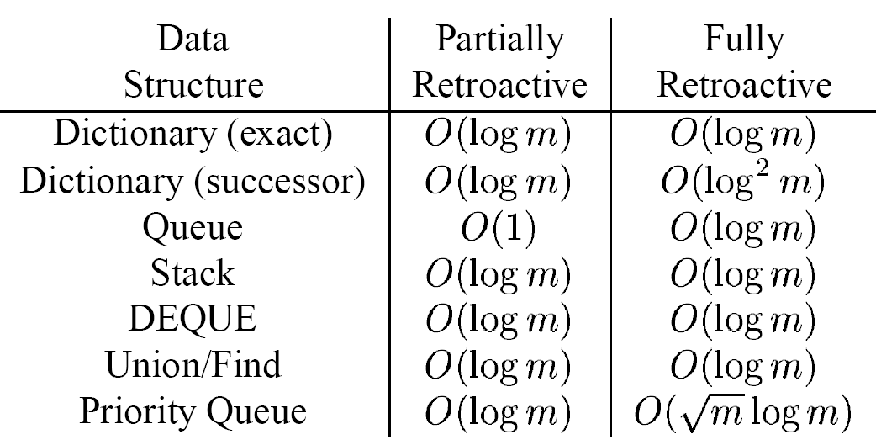
Specific Retroactive Data Structures
?
*
* [D.D. Sleator, R.E. Tarjan, A Data Structure for Dynamic Trees, Proc. 13th Annual ACM Symposium on Theory of Computing, 114-122, 1981]
Notes:
Queue = maintain a double-linked list of ALL injected elements, Head(t) = (i+1)’th injected element of i=#pop before time t.
Dictionary = commutative & order discomposable. (exact, keep for each element the disjoint intervals were it was present)

