Slide 1
Org. [D. Harel, R.E. Tarjan, Fast algorithms for finding nearest common ancestors, SIAM J. on Comp. 13 (2): 338–355, 1984]
Nearest Commen Ancestors (NCA)
Preprocessing Time vs Query Time ?
nca(i, j)
13
11
8
11
Cartesian Tree
[Vuillemin 1980]
7
6
5
3
j
4
6
2
2
i
1
1
i
j
Discrete Range Maximum
1 | 2 | 3 | 4 | 5 | 6 | 7 | 8 | 9 | 10 | 11
4 | 7 | 1 | 6 | 11 | 6 | 2 | 13 | 5 | 8 | 3
max(i, j)

Slide 2
Cartesian Tree Construction
Incremental construction left-to-right
O(n) time
18
18
+
13
13
10
10
8
2
START HERE
8
2
18 | ∙∙∙ | 13 | ∙∙∙ | 8 | ∙∙∙ | 2 | 10

Slide 3
Reduction: NCA ⇒ Discrete Range Maximum
nca(i, j)
H
Euler Tour
E
J
E
B
F
I
K
A
D
G
G
j
i
C
C
nca(i, j)
i
j
node
H | E | B | A | B | D | C | D | B | E | F | G | F | E | H | J | I | J | K | J | H
1 | 2 | 3 | 4 | 3 | 4 | 5 | 4 | 3 | 2 | 3 | 4 | 3 | 2 | 1 | 2 | 3 | 2 | 3 | 2 | 1
depth
2
minimum depth

Slide 4
NCA on Perfect Binary Trees
1
2
3
4
5
i
= nca(11,21)
10
11
2i
2i+1
20
21
22
23
11 = 1011₂
21 = 10101₂
nca(21,21) = 5 = 101₂ = lcp( 1011₂ , 10101₂ )
longest common prefix
proc lcp(x, y)
if y < x then swap (x, y)
return x >> (msb(x XOR (y >> (msb(y)-msb(x)))
position of most significant bit ≠ 0
Notes:
msb = tabulation / int-to-float conversion / using multiplication...

Slide 5
Discrete Range Mimimum - O(n∙log n) Space
nca(i, j)
1
1
1
1
3
2
1
1
3
3
4
2
3
2
1
1
2
3
4
3
4
5
4
3
2
3
4
3
2
1
2
0 1 i ∙ ∙ ∙
j
1 | 2 | 3 | 4 | 3 | 4 | 5 | 4 | 3 | 2 | 3 | 4 | 3 | 2 | 1 | 2
 | 1 | 3 |  |  |  |  |  |  |  |  |  | 3
 | 2 | 3 |  |  |  |  |  |  |  |  |  | 3
 | 3 | 3 |  |  |  |  |  |  |  |  |  | 3
 | d | 3 |  |  |  |  |  |  |  |  |  | 2
 | 5 | 1 |  |  |  |  |  |  |  |  |  | 1
right_{i}
left_{j}
drm(i, j) = min(right_{i}(d), left_{j}(d)) d = msb(i XOR j)

Slide 6
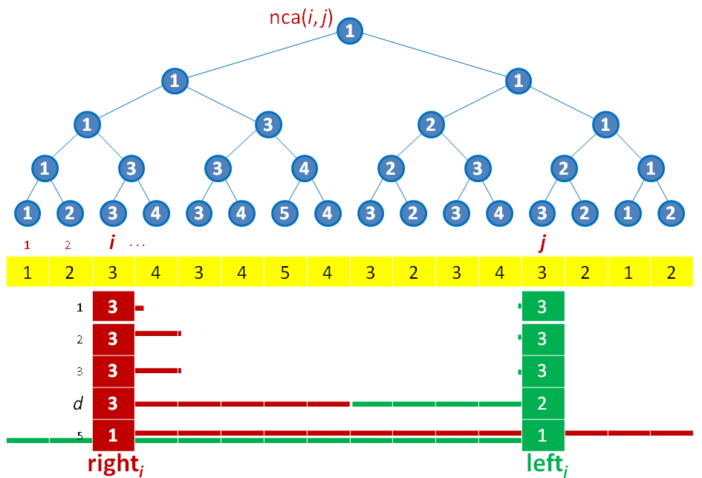
Blocked solution – O(n) space
Top structure
O(n/log n) elements
Space O(n)
Query O(1)
1 | 2 | 1 | 2
1 | 2 | 3 | 4 | 3 | 4 | 5 | 4 | 1 | 4 | 3 | 4 | 3 | 2 | 3 | 2
i
j
block of O(log n) elements
0 | 1 | 0 | 1 | 1
5 | 4 | 3 | 2 | 1
W_{j} (One for each j)
Block query: j+1-msb(W_{j} AND ((1 << (j-i+1))-1))
General query: 1 top query + 2 bottom queries
O(n) Preprocessing Time O(1) Query Time

Slide 7
Summary...
General Discrete Range Searching
i
j
1 | 2 | 3 | 4 | 5 | 6 | 7 | 8
4 | 7 | 1 | 6 | 8 | 6 | 2 | 9
Cartesian Tree
nca(i, j)
9
8
NCA
7
6
4
6
2
j
i
1
Discrete Range Max on Depth Array
1 | 2 | 3 | 4 | 3 | 4 | 5 | 4 | 3 | 2 | 3 | 4 | 3 | 2 | 1
”O(n∙log n)” solution on O(n/log n) blocks
O(log n) size blocks
O(n) Preprocessing Time O(1) Query Time

Slide 8
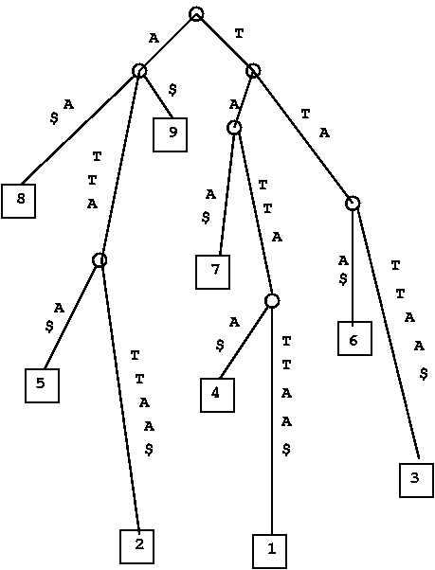
An NCA application...
i
j
1 | 2 | 3 | 4 | 5 | 6 | 7 | 8 | 9
T | A | T | T | A | T | T | A | A | $
1 | 2 | 3 | 4 | 5 | 6 | 7 | 8 | 9
T | A | T | T | A | T | T | A | A | $
Preprocess a string
Query Length of longest common substring starting a positions i and j
Suffix tree
nca(i, j)
j
Build suffix tree + NCA query
i

